Slide 1


The African Revolution
From Challenge To Opportunity
Green Energy Beyond the Obvious: Rethinking Africa’s Power Future
By Jabez Ogwal
Email: jabezogwal81@gmail.com
Contact: +256778699275
Start Here

Slide 2


Green
VS
Renewable
RENEWABLE ENERGY
GREEN ENERGY
RENEWABLE BUT NOT GREEN
    A massive hydropower dam is renewable but can flood ecosystems and displace communities. Is it truly "green"?
    Biofuels made from crops are renewable but growing them on a large scale can lead to deforestation and compete with food production. Are they "green"?
  Energy from sources that naturally replace themselves, like the sun, wind, and water. Think of it as a resource that doesn't run out..
  Renewable energy that is also environmentally friendly. This is a crucial distinction. Not all renewable energy is "green."
  Challenge: What small, daily habits can we adopt to better utilize the energy nature provides us?

Slide 3


The African Paradox:
Wealth.Vulnerability.Opportunity
01.
02.
03.
A CONTINENT OF
ABUNDANCE
THE CLIMATE DILEMA
The "Develop Now, Go Green Later" Model:
  Africa is rich in natural resources, from oil, gas, and minerals to abundant sunlight, fertile soil, and water.
  Despite being home to 17% of the world's population, Africa currently emits only 4% of global carbon dioxide emissions.
  Should Africa follow the path of developed nations like Norway, using fossil fuels to build economic wealth before transitioning to green technology? Or can we forge a new, unique path?

Slide 4

Innovation Beyond the Obvious: Rethinking Fossil Fuels
  A Paradigm Shift: What if we stopped viewing oil and gas solely as fuel to be burned? Africa can skip the "dirty phase" of development by intelligently repurposing these resources.
  Practical Innovations:
    Bioplastics & Biodegradable Polymers: Creating sustainable, single-use alternatives from fossil fuel by-products.
    Carbon Capture & Reuse: Capturing CO₂ and transforming it into valuable building materials like bricks or even new fuels.
    Waste Heat Recovery: Using heat from refineries and industrial processes to generate clean, usable power²⁵.
  Challenge: Can oil and gas by-products be re-engineered into renewable feedstocks? What other creative uses can we imagine for our existing resources?

Slide 5
The hidden cost: A realistic look at green energy
  Every energy source has trade-offs. The illusion that "green is always safe" is a dangerous oversimplification. We need to explore the complex reality.
  Cost: The high initial investment for new technologies can be a barrier for individuals and nations.
  Infrastructure: Building a continent-wide, modern grid is a monumental and costly task.
  Intermittency: Managing a consistent power supply from inconsistent sources like solar and wind requires new solutions.
Guiding Principles for Our Approach
  Resourceful: We must wisely utilize our abundant natural resources.
  Contextual: Solutions must be adapted to fit local needs and conditions.
  Balanced: We must carefully weigh the needs of economic development, environmental protection, and human well-being.
  ‘’In Africa, nature provides more power than we dare to use.’’

Slide 6
  Challenges and Considerations:
    Solar & Wind: Manufacturing solar panels requires mining rare earth metals, and they pose a growing electronic waste problem. The massive blades of wind turbines are difficult to recycle.
    Biofuels & Batteries: Widespread production of crop-based biofuels can compete with food supplies and land resources. The production and disposal of batteries can create toxic waste if not managed properly.
  Challenge: How can Africa navigate these hidden challenges? What solutions can we develop to turn these "trade-offs" into new opportunities for innovation?

Slide 7


Beyond the Grid Practical Energy Action
The power is in our Hands Practical Action for a brighter future

Slide 8

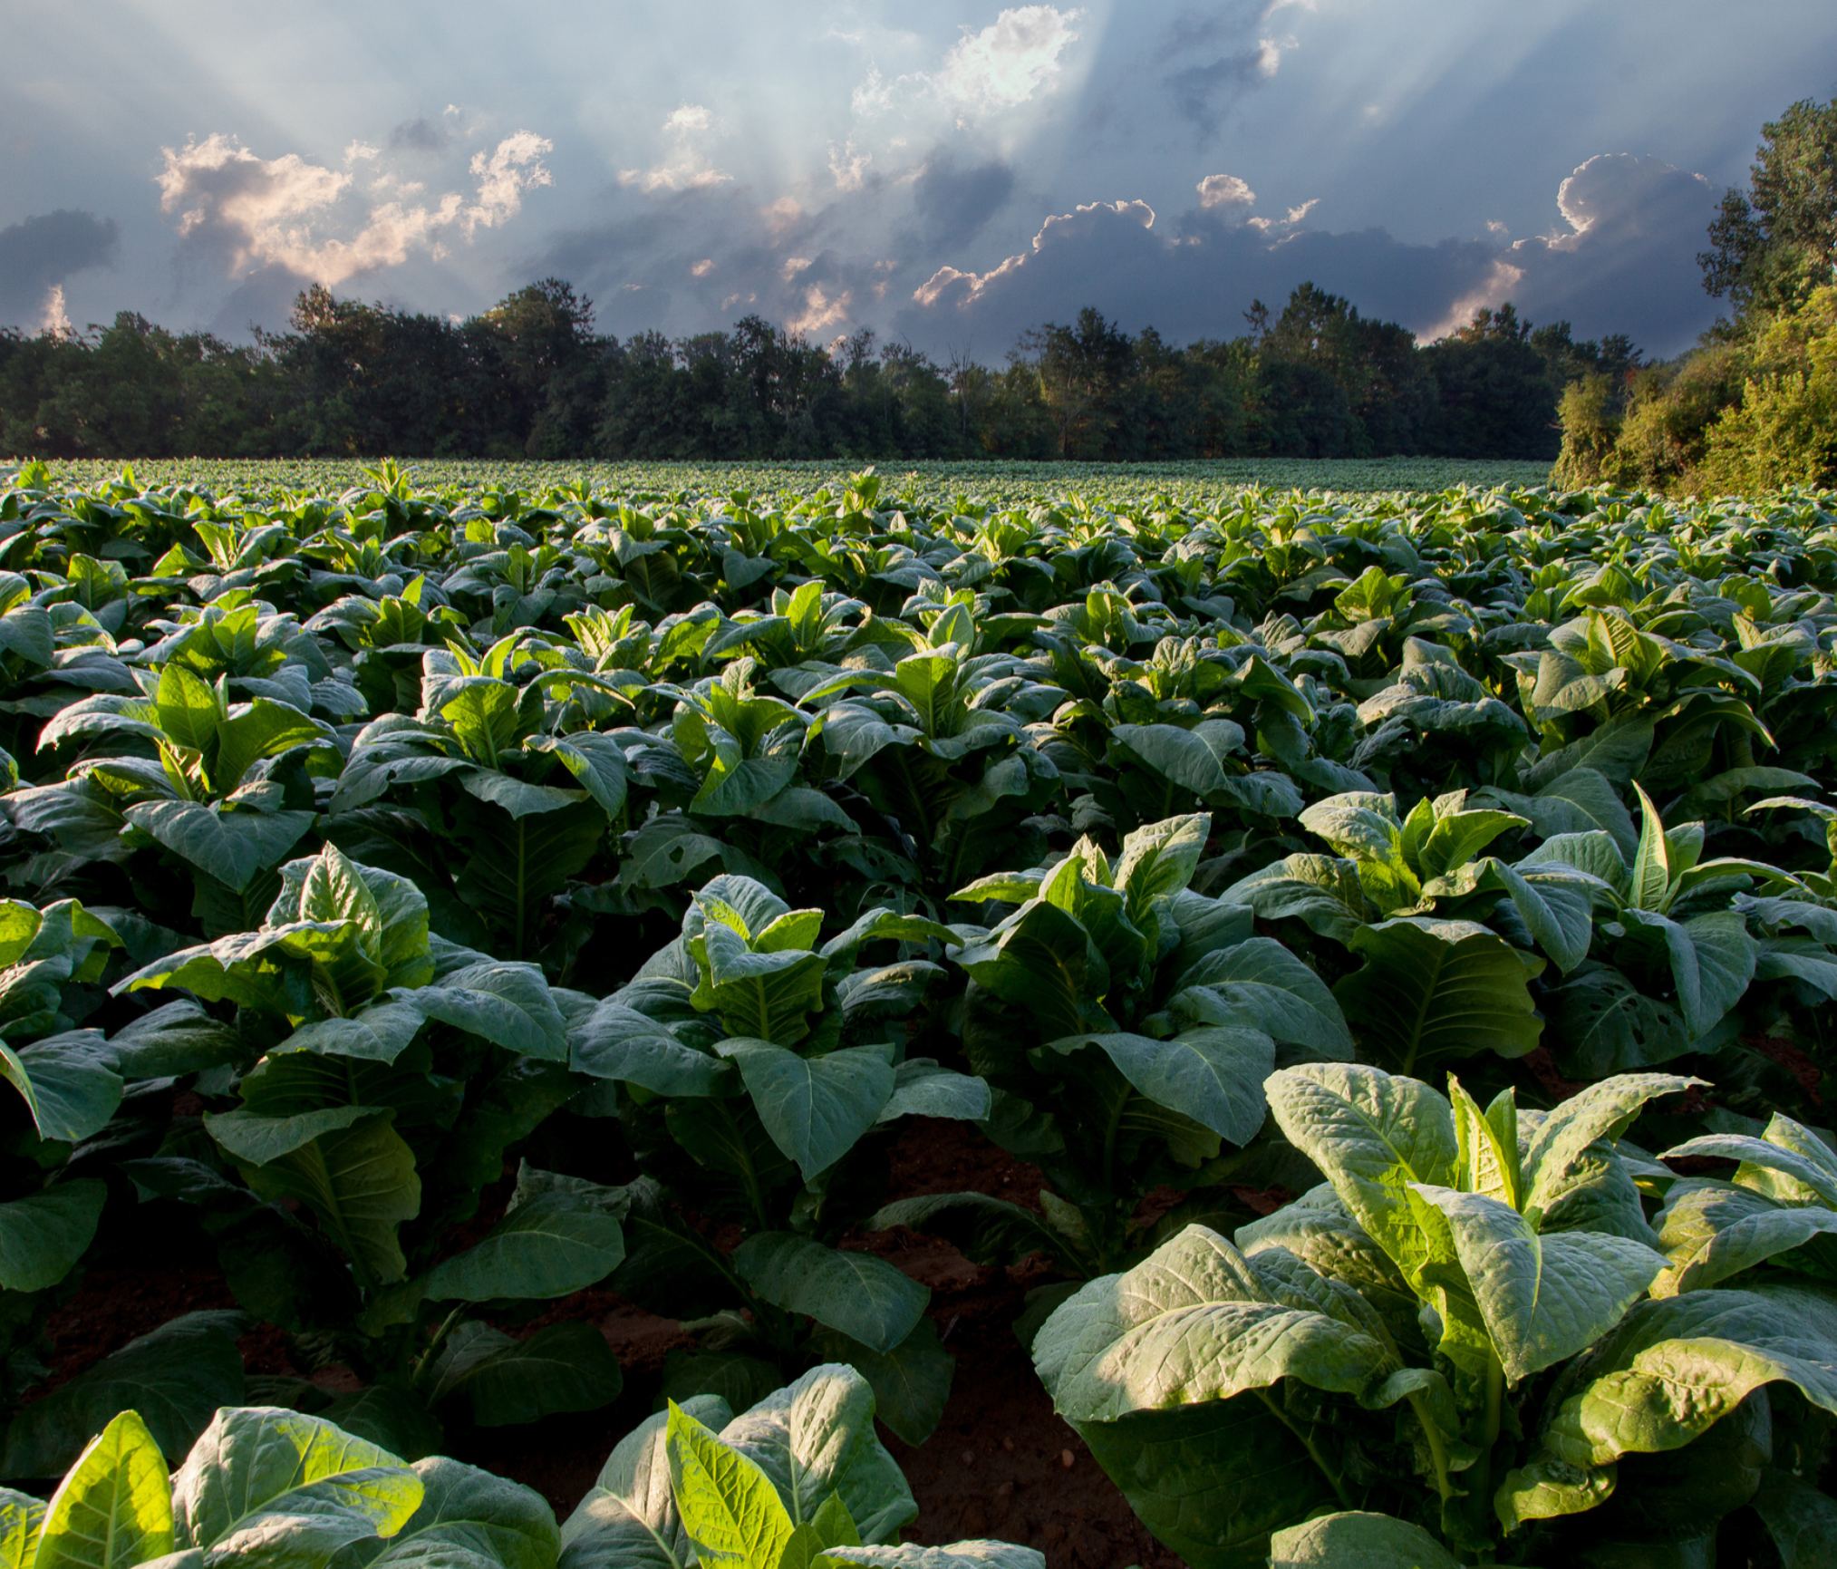
  You don't need a lab or a massive government project to make a difference. The change starts with us.
    In Your Home & Garden:
      Kitchen Power: Use a small digester to convert food scraps into biogas.
      Compost, Don't Burn: Compost organic waste to reduce emissions and enrich your soil.
    Rethinking Waste:
      Waste to Fuel: Create briquettes from agricultural waste as a cleaner alternative to charcoal.
      Circular Economy: Convert used cooking oil into biodiesel for small engines or lamps.
    Community & Longevity:
      The Repair Culture: Extend the lifespan of appliances and solar lamps through repair and maintenance.
      Community Solar: Join a co-op to access shared solar panels, making the technology more affordable and accessible for everyone.
  ‘’Every small action builds a bigger, brighter energy future’’

Slide 9





The Path Forward
Fair
Innovative
Practical Transition

Slide 10
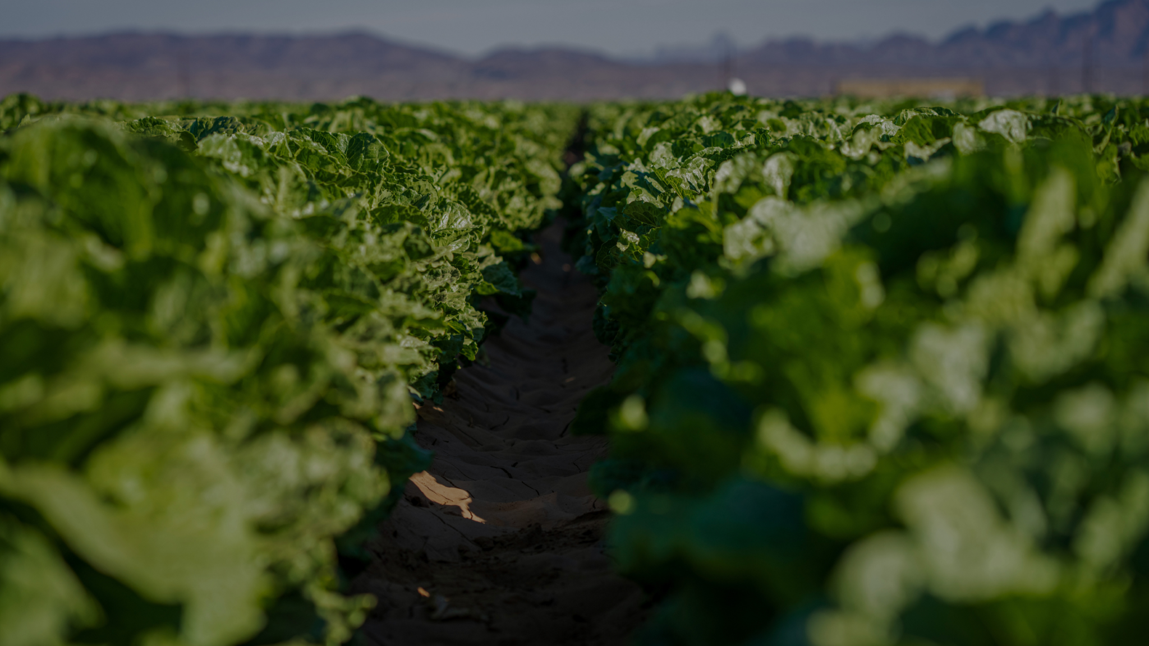
  A Final Thought: The transition to a sustainable future isn't about abandoning our resources but about reimagining them for a new era of growth.
  Our Guiding Principles:
    Equitable: The benefits of this transition must reach everyone, empowering communities, not just a privileged few.
    Innovative: We must harness Africa's unique resources—our soil, waste, sun, and minerals—in creative, new ways.
    Practical: Solutions must be affordable, reliable, and tailored to the real needs of our communities.
  Closing Statement: Africa’s unique position gives us the chance to lead the world in a new kind of green development. The time is now. The change starts with us.

